Slide 1
gScale: Scaling up GPU Virtualization with Dynamic Sharing of Graphics Memory Space
Mochi Xue, Kun Tian, Yaozu Dong, Jiacheng Ma, Jiajun Wang, Zhengwei Qi, Bingsheng He, Haibing Guan
Keon-Pyo, Lee

Slide 2
Summary
Topic :
Exsisting GPU virtualization solutions
Problem :
Still suffer from the restriction of scalability, which constrains the number of guest virtual GPU instances.
Solution :
presents a dynamic sharing mechanism which combines partition and sharing together to break the hardware limitation of global graphics memory space.

Slide 3
Background and Preliminary

Slide 4
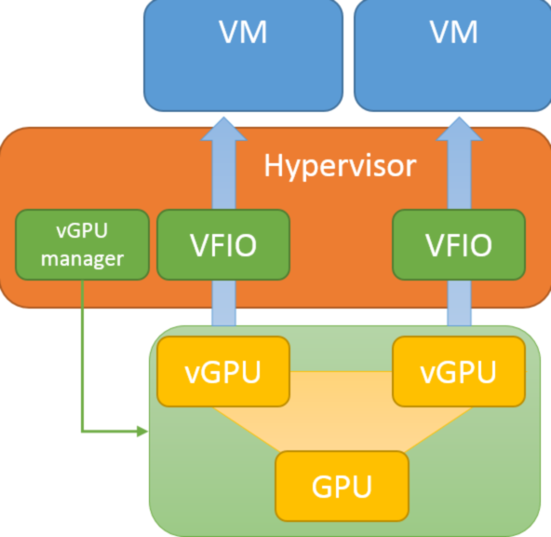
GPU Virtualization
GPU Cloud is introduced to meet the high demand of GPU resource.
As a key enabling technology of GPU Cloud, GPU virtualization is intended to provide flexible and scalable GPU resources for multiple instances.

Slide 5
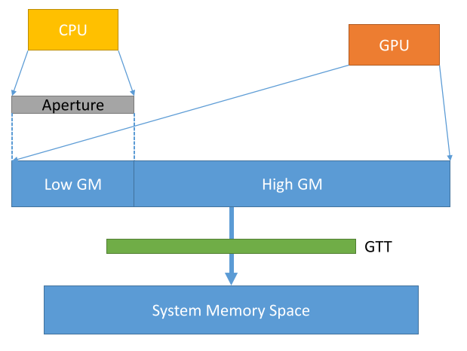
Graphics Translation Table, Global Graphics Memory Space
GTT : providing the translations from logical graphics memory address to physical memory address.

Slide 6
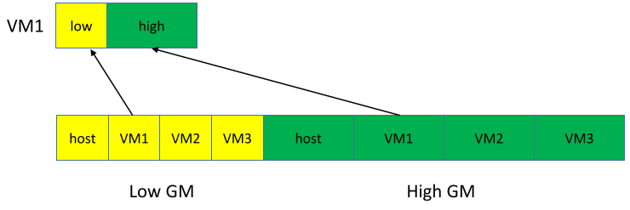
Scalability Issue
Due to the resource partition mechanism for global graphics memory space, with a fixed size of global graphics memory, the number of vGPUs hosted by gVirt is limited.
#vGPU increase, less global memory and functionality for each vGPU

Slide 7
solution

Slide 8
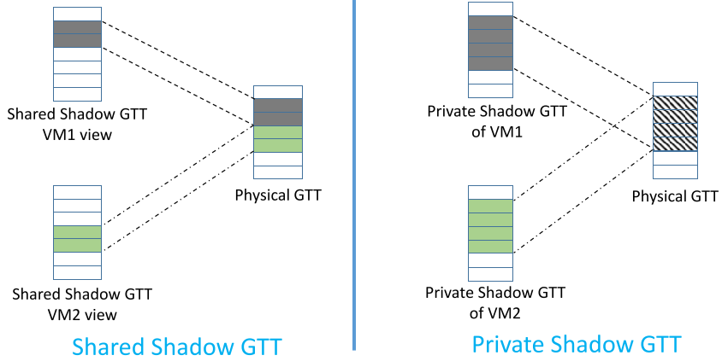
Private and Shared Shadow GTT

Slide 9
Private Shadow GTT
gScale copies vGPU’s private shadow GTT onto the physical GTT along with the context switch to ensure that translations of physical GTT are correct for the upcoming vGPU.
When vGPU owns the physical engine, gScale synchronizes the modifications of physical GTT to vGPU’s private shadow GTT
On-demand Copying
Writing private shadow GTT onto physical GTT incurs the overhead.
gScale introduces on-demand copying to reduce unnecessary copying overhead

Slide 10
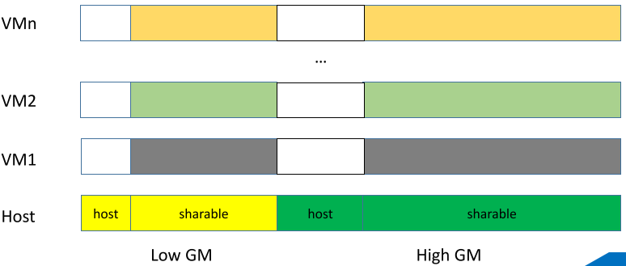
Ladder Mapping
It is not enough to only make high global graphics memory space sharable because the static partition applied to low global graphics memory space still constrains the number of vGPUs.
gScale proposes the ladder mapping to allow CPU to directly access the host memory space serving the graphics memory which bypasses the global graphics memory space.

Slide 11
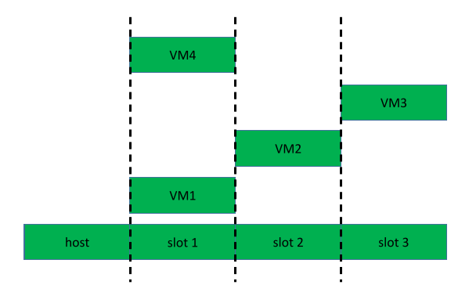
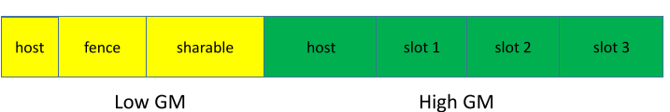
Slot Sharing
implements slot sharing to improve the performance of vGPU instance under a high instance density.
gScale divides the high global graphics memory space into several slots, and each slot could hold one vGPU’s high graphics memory.

Slide 12
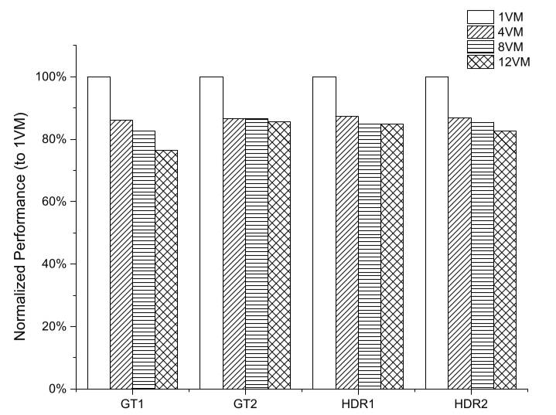
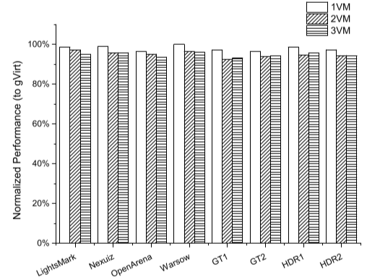
Evaluation
Results of scalability and performance comparison to gVirt

Slide 13
Conclusion
gScale addresses the scalability issue of gVirt with a novel sharing scheme.
gScale only supports Intel Graphics Processors which have integrated CPU/GPU systems and their graphics memory is also served by system memory.
Evaluation shows that gScale scales well up to 15 vGPU instances in Linux or 12 vGPU instances in Windows, which is 5x and 4x scalability compared to gVirt. Moreover, gScale archives up to 96% performance of gVirt under a high density of instances.

